Slide 1
Angular 9
By : Akash Kale

Slide 2
Day 1

Slide 3


Slide 4
Angular Framework
Angular Framework
Write Client applications using HTML and Typescript
Web, Mobile, Desktop and Native applications.
Used to develop SPA
Language used
HTML
CSS
Typescript (It is a super script of the JavaScript)

Slide 5
Angular 9
Angular allows you to develop single page applications which reload only the part of the page when user interacts with the page by clicking on a link or a button.
Angular uses components to display the content on the page and these components are replaced by other components at runtime when user wants to see other contents while interacting with the page.

Slide 6
Continue...
Angular is a framework for building client applications using HTML and Typescript (a super set of JavaScript) which is compiled to JavaScript.
Angular JS 1.x was limited to a framework to build only web applications, whereas Angular 2 or later has grown into a strong platform which allows you to develop fast and scalable applications across all platforms such as web, mobile web, native mobile and native desktop.

Slide 7
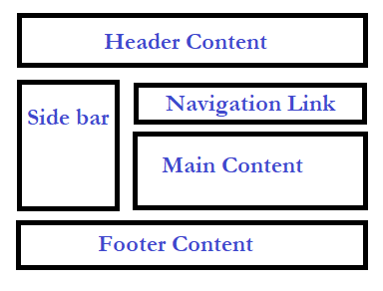
Single Page Application (SPA)
Page doesn’t fully reload
Reduces bandwidth consumption

Slide 8
Angular 9 setup
Setting up and configuring angular project takes time as it involves adding lot of
JS libraries
Compiler to Typescript
Configuring server etc
So Angular team has provided a high quality development toolset to ease the application set up and configuration one such toolset you can use is Angular CLI (Command Line Interface) which automate your development workflow.

Slide 9
Angular CLI
Create new angular application.
Run a development server with a LiveReload support to preview your application during development.
Add features to your existing angular application
build deployment and production ready application
Run your application’s unit tests
Run your application’s end to end tests(E2E tests)

Slide 10
Pre-requisites for Angular 9
HTML/HTML5
CSS/CSS3
JavaScript
TypeScript
Web Technologies (Servlet/JSP, PHP, ASP.net – Optional)

Slide 11
Software’s required
Node.js 12.x or later
NPM 6.x or later (comes with Node.js).
Editor Visual Studio Code or Brackets or Sublime.

Slide 12
The Main Building Blocks
Module
Component
Metadata
Template
Data Binding
Pipes
Service
Directive
Dependency Injection

Slide 13
Installation of Angular
ng
npm install –g @angular/cli
ng version
ng new projectName
cd projectName
npm start

Slide 14
Metadata (with decorators)
Decorators are functions that modify JavaScript classes.
Angular has many decorators that attach metadata to classes so that it knows what those classes mean and how they should work.
Decorators like a annotation in Java Technology

Slide 15
Few angular 9 decorator
Pre-defined decorator
@NgModule
@Component
@Injectable
@Input
@Output
Each decorator accepts a well-defined, specific configuration object that contains information about the class or property to be decorated.

Slide 16
Modules
Angular applications are composed of modules.
Modules contain AngularJS objects (components, directives and pipes) and also our own app’s objects.
The binding points between modules are the imports and exports.
“In Angular a module is a mechanism to group components, directives, pipes and services that are related, in such a way that it can be combined with other modules to create an application.”

Slide 17
Continue...
Technically, a module is a class with a decorator (@NgModule) that has the information of:
Which components, directives and pipes belong to the module (declarations)
Which components do you want to start first mention in (bootstrap).
Which other existing modules will be used to accomplish tasks (imports)
Which of those components, directives and pipes are allowed to be used by other modules (exports)
Provide services that are going to be used by inner objects(providers)

Slide 18
Module syntax
import { NgModule } from '@angular/core';
@NgModule({
imports: [ ... ],
declarations: [ ... ],
providers:[...],
exports:[....],
bootstrap: [ ... ]
})
export class AppModule { }

Slide 19
Components
A component is a class that controls a specific part of the screen, called the view.
A component may be a single file with everything bundled in, including css and html, or can split those (usually large) sections into separate css and html files.
The configuration object in the @Component decorator will indicate how to find each part.
“Angular component are a subset of directives. Unlike directives, components always have a template and only one component can be instantiated per an element in a template”

Slide 20
Component Syntax
import { Component } from '@angular/core';
@Component({
selector: 'app-root',
templateUrl: './app.component.html',
styleUrls: ['./app.component.css']
})
export class AppComponent {
title = ‘app';
}

Slide 21
Bootstrapping an application
To boot strap our module based application, we need to inform Angular which is the Root Module.
The main.ts is the entry point script an angular would search to bootstrap the module.

Slide 22
Sample of main.ts
import { enableProdMode } from '@angular/core';
import { platformBrowserDynamic } from '@angular/platform-browser-dynamic';
import { AppModule } from './app/app.module';
import { environment } from './environments/environment';
if (environment.production) {
enableProdMode();
}
platformBrowserDynamic().bootstrapModule(AppModule)
.catch(err => console.log(err));

Slide 23
Understanding the File structure:-
app/app.component.ts – This is where we define our root component
app/app.component.html --This is the template or html page where we write presentation logic
app/appcomponent.css --This is the css file where we can write formatting style
app/app.module.ts – The entry Angular Module is bootstrapped
index.html – This is the page the component will be rendered in
app/main.ts – This the glue that combines the component and page together

Slide 24
Execution Flow
ng serve
run
main.ts
launch
app.module.ts
bootstrap
app.component.ts
display
template
Browser
load
index.html
<app-root>
render
app.component.html
</></>

Slide 25
Why node.js ?
“Node's goal is to provide an easy way to build scalable Network programs”

Slide 26
Node.js
Earlier
Javascripts were run on browsers (runtime environment)
Limited Javascript libraries
Node.js
Runtime environment for Javascript
Benefits
Provides vast number of Javascript libraries
Server-side code can be written in Javascript
Frontend developers can use Javascript for Backend coding

Slide 27
What is NodeJS ?
NodeJS is an open source , cross platform runtime environment for server side and networking application.
It is written in JavaScript and can run on Linux , Mac ,Windows , FreeBSD.
It provided an event driven architecture and a non blocking I/O that optimize and scalability. These technology uses for real time application.
It used Google JavaScript V8 Engine to Execute Code.
It is used by Groupon, SAP , LinkedIn ,Microsoft,Yahoo ,Walmart ,Paypal.

Slide 28
What is unique about Node.js?
JavaScript used in client-side but node.js puts the JavaScript on server-side thus making communication between client and server will happen in same language
Servers are normally thread based but Node.JS is “Event” based. Node.JS serves each request in a Event loop that can able to handle simultaneous requests.
Node.JS programs are executed by V8 JavaScript engine the same used by Google chrome browser.
Notes:
Thread based servers like Apache server will serve each web request as individual threads which doesn’t fit well for concurrent connections.

Slide 29
Node.js is not……
● Another Web framework
● For beginner
● Multi-thread
In Simple Node.js
Node.js = Runtime Environment + JavaScript library.

Slide 30
Why node.js ?
● Non Blocking I/O
● V8 JavaScript Engine
● Single Thread with Event Loop
● 40,025 modules
● Windows, Linux, Mac
● 1 Language for Frontend and Backend
● Active community

Slide 31
Why JavaScript ?!!!
Friendly Callbacks
Ubiquitous
No I/o Primitives
One language to RULE them all
JavaScript is well known for client-side scripts running inside the browser
node.js is JavaScript running on the server-side
SSJS -> Server-Side JavaScript
Use a language you know
Use the same language for client side and server side

Slide 32
NPM
Node Package Manager
A standard package manager for Node.js
Downloads & Manages dependencies of Node.js packages
You can use some options in npm like:
npm install
npm install <package-name>
npm update
npm run
npm uninstall

Slide 33
ES6
JavaScript is ES6 or ES 2015 as well as ES7 or ES2016, ES means ECMAScript which is a standard for scripting language ECMA means European Computer Manufacturer's Association.
The ES6 or ES6 script can’t understand by browser.
So it required transpiler, which help to convert ES6 or ES7 to ES5(JavaScript).
TypeScript transpiler
Babel transpiler
Traceur transpiler

Slide 34
TypeScript
TypeScript is a free and open source programming language developed and maintained by Microsoft.
It is a strict superset of JavaScript, and adds optional static typing and class-based object-oriented programming to the language.
It is designed for development of large applications and transpiler to JavaScript. As TypeScript is a superset of JavaScript, any existing JavaScript programs are also valid TypeScript programs.

Slide 35
Features of the TypeScript
Data Types Supported
ES6 function
Classes
Inheritance
Interface
Modules
Source File Dependencies

Slide 36
Variable declaration
In ES6, we can use var, let and const keyword to declare the variable.
var keyword is used to declare the function scoped variable.
let keyword is used to declare the block scoped variable.
const keyword is used to declare the constant value.

Slide 37
Data Types
Any
Primitive
number
boolean
string
void
null
undefined - Same as JS
Array
Enum

Slide 38
TypeScript functions
Normal function
Function with parameter
Function with parameter variable with datatype
Function with return types.
Function with required parameter
Function with default parameters
Function with optional parameters

Slide 39
Continue...
Rest parameter
Spread parameter
Arrow function (lambda expression)
Function return more than one value

Slide 40
ES6 String
let msg1=“Simple Msg”; //double quote
let msg2=‘Simple Msg’; // single quote
let msg3=`Simple Msg`;//backticks quote
let name =“Raj Deep”;
let msg4 = `The name is
${name} `; //string template

Slide 41
Different way for loop
let abc=[“a”,”b”,”c”,”d”]
First way
for(let i=0;i<abc.length;i++){
console.log(abc[i])
}
Second way
for(let index in abc) {
console.log(abc[index])
}

Slide 42
Continue...
Third way
for(let val of abc) {
console.log(val)
}
Fourth way
abc.forEach(function(value){
console.lot(value)
})

Slide 43
using arrow function
Fifth way
abc.forEach((value)=>console.log(value))

Slide 44
Classes
Contains set of properties and behaviour
Instance methods/members
Static methods/members
Can implement interfaces
Inheritance
Single constructor
Default/Optional parameter
ES6 class syntax

Slide 45
Inheritances
Using classes
Using interface

Slide 46
Modules
Modules can be defined using module keyword
A module can contains sub-modules, class, enum or interfaces. But can’t directly contains functions.
Modules can be nested(sub-modules).
Classes and Interfaces can be exposed using export keyword.

Slide 47
Types of module
Internal module
External module

Slide 48
Sample Example internal module
a.ts
module A{
export function abc(){
console.log("Abc function from a.ts")
}
}
b.ts
module B {
export function abc() {
console.log("Abc function from b.ts")
}
}
main.ts
///<reference path="./a.ts"/>
///<reference path="./b.ts"/>
A.abc();
B.abc();

Slide 49
Sample Example external module
a.ts
export function abc(){
console.log("Abc function from a.ts")
}
b.ts
export function xyz() {
console.log(“Xyz function from b.ts")
}
}
main.ts
import {abc} from "./a";
import {xyz} from "./b";
abc();
xyz();

Slide 50
TypeScript Decorators
Decorator is nothing but it is special kind of declaration that can be attached to the classes, properties and methods.
Decorator can be evaluated into a function that to be called at the runtime. The decorator being with the @ symbol.

Slide 51
Angular Continue…

Slide 52
How to create components
@Component
Decorator used to create components
Present in the @angular/core
It will have selector, templateUrl and styleUrls
Command: ng g c component-name

Slide 53
Data binding
Data binding is the connection bridge between view and the business logic (View Model) of the application.
Data binding in Angular is the automatic synchronization between model and the view.
When the Model changes, the view are automatically updated and vice-versa.

Slide 54
We can achieve totally four ways
Interpolation
One way binding
Event binding
Two way binding

Slide 55
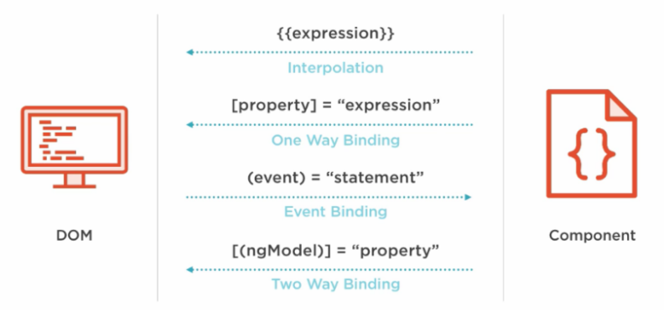

Slide 56
Interpolation
This is the easiest way of data binding in Angular JS. This is same as expression in Angular 1.x. In interpolation.
we need to supply property name is the view template, enclosed in double curly braces, eg. {{name}}.
It is used for one-way binding (Component class to View only).

Slide 57
Property binding
Property binding also known as one – way data binding.
Property binding use [] to send value from the Component to the template(View).
The ng-bind directives is used for one-way binding in Angular 1.x.
Angular 2 uses HTML DOM element property for one-way binding. The square brackets are used with property name for one-way data binding in Angular 2.
<p>Welcome to <span [innerText]="title"></span></p>
Enter Full Name :<input type="text" [value]="fullName">

Slide 58
Interpolation Vs Property binding
String interpolation - {{expression}} - render the bound value from component's template and it converts this expression into a string.
Property binding - [target]="expression" - does the same thing by rendering value from component to template.
But if you want to bind the expression that is other than string (for example - boolean), then property binding is the best option.

Slide 59
Two – way binding
But it is replaced with [(ngModel)] in Angular 2.0. The ngModel directive is part of the build-in Angular module called "FormsModule".
So, we must import this module in to the template module before using the ngModel directive.
<input [(ngModel)]="userName">
The User Name is {{userName}}

Slide 60
Event Binding
Angular 2.0 directly uses the valid HTML DOM elements event. For example, ng-click is now replaced by (click).
The round brackets (parentheses) are used with DOM event name for event binding in Angular 2.
(click)
(dblclick)
(mouseenter)
(mousedown)
(keyup)
(keydown)
(submit) etc

Slide 61
Template reference
Angular 2 has feature called "template reference variables". With this features.
We are able to have directive access to an element. The template reference variable is declared by preceding an identifiers with a hash/pound character (#).
With reference template is completely self-contained and it doesn't bind to the component.
This solution will not work unless we bind to the element's event.
<input #userName type="text" (keyup)="0">
The User Name is {{userName.value}}

Slide 62
Day 2

Slide 63
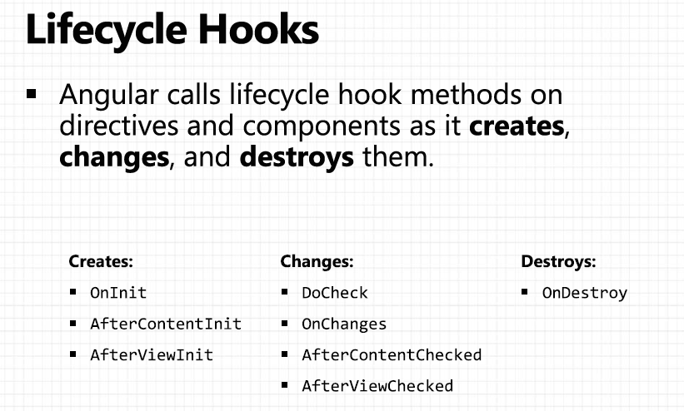

Slide 64
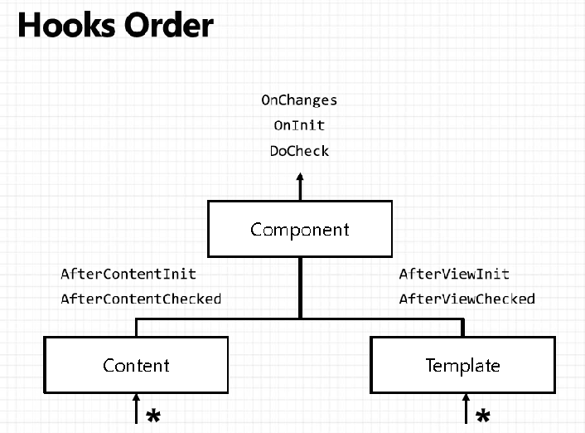

Slide 65
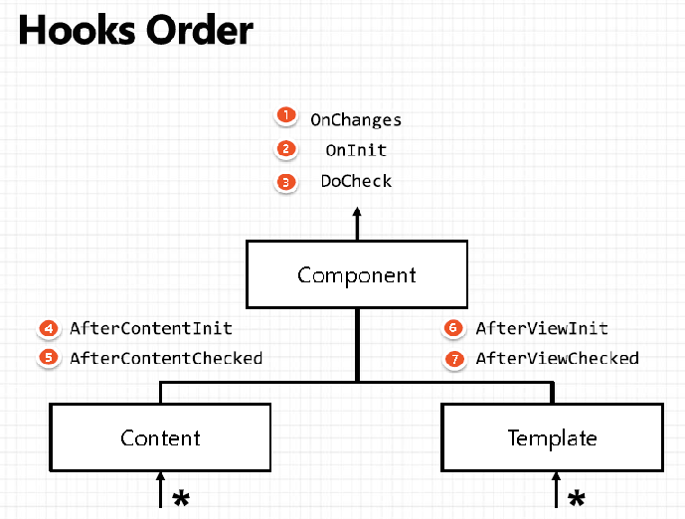

Slide 66
Life cycle methods
ngOnChanges : This event executes every time when a value of an input control within the component has been changed.
ngOnInit : This event initializes after Angular first displays the data-bound properties or when the component has been initialized. This event is basically called only after the ngOnChanges()events. This event is mainly used for the initialize data in a component.
ngDoCheck – This event is triggered every time the input properties of a component are checked. We can use this hook method to implement the check with our own logic check.

Slide 67
Continue...
ngAfterContentInit – This lifecycle method is executed when Angular performs any content projection within the component views. This method executes when all the bindings of the component need to be checked for the first time.
ngAfterContentChecked – This lifecycle hook method executes every time the content of the component has been checked by the change detection mechanism of Angular. This method is called after the ngAfterContentInit() method. This method is also called on every subsequent execution of ngDoCheck().

Slide 68
Continue...
ngAfterViewInit – This lifecycle hook method executes when the component’s view has been fully initialized. This method is initialized after Angular initializes the component’s view and child views.
ngAfterViewChecked – This method is called after the ngAterViewInit() method. This method also executes when any binding of the children directives has been changed. So this method is very useful when the component waits for some value which is coming from its child components.
ngOnDestroy – This method will be executed just before Angular destroys the components. This method is called just before the component is removed from the DOM.

Slide 69
Components communication
Component communication
Parent to Child passing the data using @Input – Child Level
Child to Parent passing the data using @Output with EventEmitter. – Child Level
Child to Parent passing the data @ViewChild – Parent Level
Passing the data between sibling
Using common Service provided by ngModule - @Injectable
Using common Service BehaviourSubject - RxJS
Using localStorage / sessionStorage – JavaScript

Slide 70
@Input()
Parent property is assigned to the child property via property binding syntax
In .ts file
Parent Component
parentProperty : Type
In Template file
<child-component [childProperty]= “parentProperty”></child..>
In .ts file
Child Component
@Input() childProperty: Type
In Template file
<p> {{childProperty}}</p>

Slide 71
@Output
Child property is assigned to the parent property via event binding syntax
Parent Component
parentProperty : Type
eventHandler(fromChild) { ... }
<child-component (eventEmitter)=“eventHandler($event)”></...>
Child Component
@Output() eventEmitter= new EventEmitter<Type>()
someMethod(value) { this.eventEmitter.emit(value) }

Slide 72
Child to parent using @ViewChild
ViewChild allows a one component to be injected into another, giving the parent access to its attribute and functions.
The child won't be available until after the view has been initialized.
This means we need to implement the AfterViewInit lifecycle hook to receive the data from the child.

Slide 73
Continue...
Parent component
@ViewChild(ChildComponentComponent)
childRef;
age:number;
ngAfterViewInit() {
this.age = this.childRef.empAge;
}
Child component
empAge:number=25

Slide 74
Angular Testing – Component and Template

Slide 75
Testing Angular
Writing tests is intended to explore and confirm the behaviour of the application.
Testing does the following:
Guards against changes that break existing code (“regressions”).
Clarifies what the code does both when used as intended and when faced with deviant conditions.
Reveals mistakes in design and implementation.

Slide 76
Types of Testing
Unit Tests
Smallest possible unit of testing
Cover one small unit and don’t bother about how multiple units work together.
Fast, reliable and point in the exact direction of the bug.
Integration Tests
Cover multiple units.
Point out important bugs that would show up when multiple components run
together in the application.
End-to-end Tests
Simulate a production like environment.
It’s as simple as testing your application from start to finish – just like a user.
We can run end to end tests on multiple browsers and find bugs that emerge in certain environments / browsers – such as… Internet Explorer.

Slide 77
Tools and Technologies
You can write and run Angular tests with a variety of tools and technologies
Jasmine
Behaviour-driven development framework for testing JavaScript code.
Provides everything needed to write basic tests.
Angular testing utilities
Create a test environment for the Angular application code under test.
Used to condition and control parts of the application as they interact within the Angular environment.

Slide 78
Continue…
Karma
Ideal for writing and running unit tests while developing the application.
Can be an integral part of the project's development and continuous integration processes.
Protractor
Run end-to-end (e2e) tests to explore the application as users experience it.
One process runs the real application and a second process runs protractor tests that simulate user behaviour and assert that the application responds in the browser as expected.

Slide 79
Testing Recommendations
Put unit test spec files in the same folder as the application source code files they test
Such tests are easy to find.
You see at a glance if a part of your application lacks tests.
Nearby tests can reveal how a part works in context.
When you move the source (inevitable), you remember to move the test.
When you rename the source file (inevitable), you remember to rename the test file.

Slide 80
UNIT TESTING WITH JASMINE AND KARMA

Slide 81
Unit Testing with Jasmine
Behaviour-driven development framework for testing JavaScript code
Does not depend on any other JavaScript frameworks
Does not require a DOM
Jasmine tests are a set of Test Suites each composed of a set of Test
Specs
Call describe to define a test suite, and it to define a spec
A spec contains one or more expectations that test the state of the code
A spec with all true expectations is a passing spec.
A spec with one or more false expectations is a failing spec.
Provides the global beforeEach, afterEach, beforeAll, and afterAll functions
Help a test suite DRY (Don't Repeat Yourself ) up any duplicated setup

Slide 82
Karma Test Runner
Karma provides a suitable testing environment to any web developer
browsers do not have natively a concept of loading tests files, running them, and reporting results.
Karma:
Starts a small web server to serve "client-side" javascript files to be tested
Serves the "client-side" javascript files with the tests (or Specs, as they're often called)
Serves a custom web page that will run javascript code for the tests
Starts a browser to load this page
Reports the results of the test to the server
Reports the results to text files, console, etc...

Slide 83
Angular Testing Utilities
Isolated unit tests
Examine an instance of a class all by itself without any dependencies on Angular or any injected values
The tester creates a test instance of the class with new, supplying test
doubles for the constructor parameters as needed, and then probes the test instance API surface.
Should be written for pipes and services
Angular Testing Utilities
Helper functions from @angular/core/testing
Used for components
Contrary to isolated unit tests, they can show how components interact with
Angular, and how they interact with their own templates

Slide 84
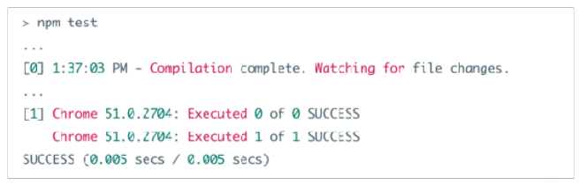
Writing Tests
In order to write and run unit tests:
Create a spec file in the same folder : usually, they have the same name as the file they are testing, with the .spec.ts extension
Run with karma using: npm test
Focus on the console output to see the result, that should look like this:
[0] is the compiler output, [1] is Karma output

Slide 85
Testing a Component
TestBed
Most important Angular testing utility
Creates an Angular testing module (@NgModule class) that you configure using configureTestingModule to add importas, dependencies…
Enables the framework to detach the tested component from its own application module and re-attach it to the test module
TestBed.createComponent
Creates an instance of the component under test
Closes the TestBed to any further configuration
ComponentFixture
A handle on the test environment surrounding the created component
Provides access to the component instance itself

Slide 86
Continue…
DebugElement
Handle on the component's DOM element
Used to query for any HTML element of the component's template
By
Angular testing utility that produces useful predicates
By.css produces a standard CSS selector
nativeElement
Returns the queried DOM element from the DebugElement
fixture.detectChanges
Detects changes of the component code to trigger data bindings and propagation
createComponent does not automatically trigger change detection, you have to do it manually

Slide 87
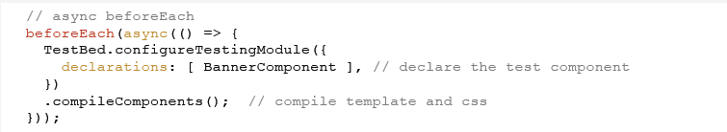
Testing a Component with External Template
TestBed.createComponent is a synchronous method, whereas the Angular template compiler reads the external files from the system asynchronously
The test setup for the component must give the Angular template compiler time to read the files
• A first beforeEach must handle asynchronous compilation (use async())
Call the asynchronous compileComponents method to compile all the components of the testing module
A synchronous beforeEach containing the remaining setup steps follows the asynchronous beforeEach.

Slide 88
Angular Service

Slide 89
Angular Service
Services allow for greater separation of concerns for your application and better modularity by allowing you to extract common functionality out of component.
Service is used when a common functionality need to be provided for various modules.
Angular also comes with its own dependency injection framework for resolving dependencies, so you can have your services depend on other services through out your application, and dependency injection will resolve your dependencies for you.

Slide 90
Dependency Injection
DI is a coding pattern in which a class receives its dependencies from external sources rather than creating them itself.

Slide 91
Types of Service in Angular 9
User-defined service
Pre-defined service

Slide 92
Steps to create the Service
Import the injectable member
Add the @injectable Decorator
Export Service class

Slide 93
Register the Service
We can register the service in two ways
In Component
In Module

Slide 94
In Component
There are four simple steps to use/import Service in the Component
import the Service to the component
Add it as a provider
Include it through Dependency injection
Use the Service function

Slide 95
http service from Angular 4.2 onwards
HttpClient:- It is for callback, used for performing XMLHttpRequest operations like get(), post(), delete(), put(),
All the Http methods return Observable, from Observable map() operator is optional, the data would be in a Response which you get once you call subscribe() method

Slide 96
Retrieve json static data.
Using Angular HttpClient retrieve the static json data.

Slide 97
Angular JS directives
Directive allow you to attach behaviour to element in the DOM.
There are three types of directives
Component directive : directives with a template
Structural directive : change the DOM layout by adding and removing DOM elements.
Attribute directive : change the appearance or behaviour of an element, component or another directive.

Slide 98
Component directives
Angular component are a subset of directives. Unlike directives, components always have a template and only one component can be instantiated per an element in a template.
The specific type of directive that allows us to utilize web component functionality encapsulated, reusable elements available through our application.

Slide 99
Component directive
We can create a component like so
@Component({
selector:"my-component",
tempalte:"<p>This is user defined component</p>”
})
export class MyComponent {}

Slide 100
Structure directives
Structural directives are responsible for HTML layout.
They shape or reshape the DOM's structure, typically by adding, removing or manipulating elements.
An asterisk (*) precedes the directive attribute names.

Slide 101
Built – in structural directive
Three of the common, built-in structural directives
*ngIf
*ngFor
ngSwitch
[ngSwitch]
*ngSwitchCase
*ngSwitchDefault

Slide 102
Attribute directives
Attribute directives changes the appearance or behaviour of an element.
Attribute directives are surrounded by brackets which sign to Angular that the appearance or behaviour of the DOM elements within the directive may change depending on certain conditions.
In Angular 9 are ngStyle and ngClass are the built-in attribute directives.
In Angular 1.x there was the ng-show and ng-hide directives, which show or hide elements depending on what the given expression evaluates to by setting the display CSS property.

Slide 103
Sample demo
<p [ngClass]=" 'myClass' ">Apply style binding - Using ngClass</p>
<p [ngClass]="{classOne:cone,classTwo:ctwo}">ngClass paragraph is here!</p>
<p [ngStyle]="{'color':colorValue,'font-size':fsize}">ngStyle paragraph is here!</p>
<p [ngStyle]=“ styleVariable”>ngStyle paragraph is here!</p>

Slide 104
Custom directive
import required modules like Directive, ElementRef,ViewContainerRef from Angular 9 core library.
Create a TypeScript class decorate the class with @directive
Set the value of the selector property in @directive decorator function. The directive would be used, using the selector value on the elements.
In the constructor of the class, inject TemplateRef and ViewContainerRef.

Slide 105
Day 3

Slide 106
Angular 9 forms
Angular totally provided two types of forms
Template Driven Forms
Model Driven or Reactive approach Forms

Slide 107
TDF Vs MDF
Easy to use
Suitable for simple scenarios and fails for complex scenarios
Two way data binding(using [(NgModel)] syntax)
Minimal component code
More flexible, but needs a lot of practice
Handles any complex scenarios
No data binding is done
More component code and less HTML markup

Slide 108
Template driven form
When we want to use the template driven form first we have to use the FormsModule in module(AppModule).
The we have to use the ngForm Directives.
It provides use information about the current state of the form state of the form including.
A JSON representation of the form value.
Validity state of the entire form.

Slide 109
ngFormDirective
<form #formRef="ngForm" (submit)="checkValue(formRef.value)">
</form>

Slide 110
ngModel directive
In order to register form controls on an ngForm instance we use the ngModel directive.
In combination with a name attribute, ngModel creates a form control abstraction for use behind the scenes.
Every form controls that is registered with ngModel will automatically shows up in form.value

Slide 111
ngForm with ngModel
<form #formRef="ngForm" (submit)="checkValue(formRef.value)">
<input type=“text” name=“uname” ngModel>
</form>

Slide 112
ngModelGroup
<div ngModelGroup="FullName">
FirstName:<input type="text" name="fname"ngModel>
LastName:<input type="text" name="lname"ngModel>
</div>

Slide 113
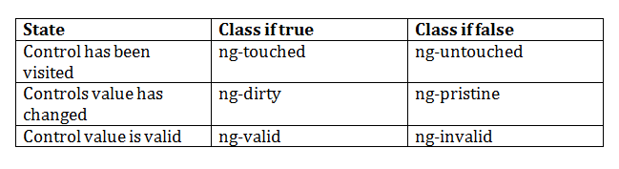
Angular pre-defined validation classes
componentRefName.errors.required
componentRefName.errors.minlength
componentRefName.errors.maxlength

Slide 114
ngForm with ngModel with Validation
<form #formObj="ngForm“ (ngSubmit)="verify(formObj.value)“ nonvalidate>
<input type="text" name="user" ngModel required #userRef="ngModel” minlength="2"/>
<div *ngIf="userRef.errors && (userRef.dirty || userRef.touched)">
<span [hidden]="!userRef.errors.required">
UserName is required
</span>
<span [hidden]="!userRef.errors.minlength">
UserName must be 2 character
</span>
</div>
<input type="submit" [disabled]="!formObj.valid">

Slide 115
Model Driven Forms
Model Driven Forms also known as Reactive forms.
In this approach, we create new instances of the form controls and form control group in our component.
When we want to use the model driven form first we have to use the ReactiveFormsModule in module(AppModule).

Slide 116
FormGroup and FormGroupControl
FormControl : The class is present in the "@angular/forms" package of Angular 2.0.Each component in form like textfield, radiobutton, checkbox is known as FormControl
FormGroup : The class is present in the "@angular/forms" package of Angular 2.0. It is used to represent a set of form control inside its constructor.

Slide 117
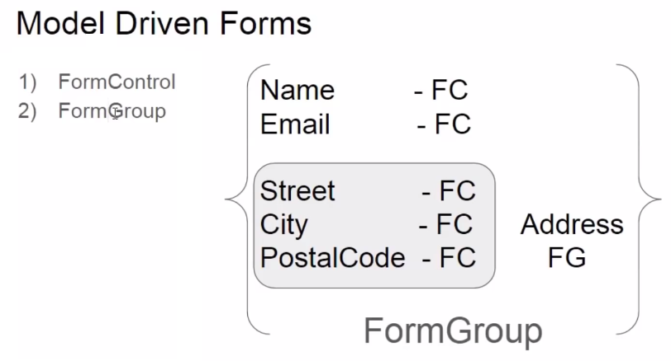

Slide 118
In Component
userForm=new FormGroup({
uname:new FormControl(),
pname:new FormControl(),
addressForm=new FormGroup({
.....
.....
})
});

Slide 119
In Template
<form [fromGroup]=“userForm”>
<input type=“text” formControlName=“uname”>
........
........
........
</form>

Slide 120
Model Driven form with Validation
Import the Validators from the ‘@angular/forms”.
Which provide set of field which help to do the validation.
userForm=new FormGroup({
uname:new FormControl(‘’,[Validators.required,Validators.minLength(3)]),
pname:new FormControl(‘’,[Validators.required,Validators.maxLength(6)]),
});

Slide 121
<form [formGroup]="loginForm" (submit)="verify()" nonvalidate>
<input type="text" formControlName="user" required/>
div *ngIf="!loginForm.controls.user?.valid && (loginForm.controls.user?.dirty
|| loginForm.controls.user?.touched)">
<div [hidden]="!loginForm.controls.user.errors.required">
UserName is required
</div>
<div [hidden]="!loginForm.controls.user.errors.minlength">
Min Length must be 2 character
</div>
</div>
<input type="submit" value="submit" [disabled]="!loginForm.valid">

Slide 122
Angular Service – Continue…

Slide 123
Angular Service
Services allow for greater separation of concerns for your application and better modularity by allowing you to extract common functionality out of component.
Service is used when a common functionality need to be provided for various modules.
Angular also comes with its own dependency injection framework for resolving dependencies, so you can have your services depend on other services through out your application, and dependency injection will resolve your dependencies for you.

Slide 124
Dependency Injection
DI is a coding pattern in which a class receives its dependencies from external sources rather than creating them itself.

Slide 125
Types of Service in Angular 9
User-defined service
Pre-defined service

Slide 126
Steps to create the Service
Import the injectable member
Add the @injectable Decorator
Export Service class

Slide 127
Register the Service
We can register the service in two ways
In Component
In Module

Slide 128
In Component
There are four simple steps to use/import Service in the Component
import the Service to the component
Add it as a provider
Include it through Dependency injection
Use the Service function

Slide 129
http service from Angular 4.2 onwards
HttpClient:- It is for callback, used for performing XMLHttpRequest operations like get(), post(), delete(), put(),
All the Http methods return Observable, from Observable map() operator is optional, the data would be in a Response which you get once you call subscribe() method

Slide 130
In Module
There are four simple steps to use/import Service in the Module
import the Service to the module
Add it as a provider
Include it through Dependency injection in Component
Use the Service function

Slide 131
Angular 9 http service
One of the most common scenario in any application is client interacting with the server.
Http is the widely used protocol for this interaction.
One can fetch data from the server, update data, create data and delete data using HTTP protocol.
In Angular 2 http service return the Observable but Angular 1.x is http service return the Promise object.

Slide 132
JavaScript callback function
A callback function is a function passed into another function as an argument, which is then invoked inside the outer function to complete some kind of routine or action.
Callback function may be synchronous and asynchronous functions.

Slide 133
Synchronous and Asynchronous
In synchronous programs, if you have two lines of code (L1 followed by L2), then L2 cannot begin running until L1 has finished executing.
In asynchronous programs, you can have two lines of code (L1 followed by L2), where L1 schedules some task to be run in the future, but L2 runs before that task completes.

Slide 134
What is promise
Promise is a one type of callback function, which represents the eventual result of an operation. You can use a promise to specify what to do when an operation eventually succeeds or fails.

Slide 135
The Promise
The Promise is an object, with two functions.
then() => Promise, please get the value from that URL.
error() => Promise, please call this function when you have a new error for me.

Slide 136
Observer pattern
The observer pattern is a software design pattern in which an object, called the subject, maintains a list of its dependents, called observers, and notifies them automatically of any state changes, usually by calling one of their methods. It is mainly used to implement distributed event handling systems.

Slide 137
Observables in Angular
You can think of an observable as an array whose items arrive asynchronously over time.
Observables help you manage asynchronous data, such as data coming from a backend service. Observables are used within Angular itself, including AngularJS event system and its http client service. To use observables, Angular uses a third-party library called Reactive Extensions (RxJS). Observables are a proposed feature for ES 2016, the next version of JavaScript.

Slide 138
The Observer
The Observer is an object, with three functions.
next() => Observable, please call this function when you have a new value for me.
error() => Observable, please call this function when you have a new error for me.
complete() => Observable, please call this function when you complete your job.

Slide 139
Observable Vs Promise
Observables
Observables handle multiple values over time.
Observable are cancellable.
Promise
Promise are only called once and will return a single value.
Promises are not cancellable.

Slide 140
What is RxJS
RxJS or Reactive Extensions for JavaScript is a library for transforming, composing, and querying streams of data.
We mean all kinds of data too, from simple arrays of values, to series of events
RxJS can be used both in the browser or in the server-side using Node.js.
Asynchronous, in JavaScript means we can call a function and register a callback to be notified when results are available.
Data, raw information in the form of JavaScript data types as: Number, String, Objects (Arrays, Sets, Maps).
Streams, sequences of data made available over time.

Slide 141
Demo Example
var Rx=require("rx");
var source = Rx.Observable.range(1,5);
var sub = source.subscribe(
x=>console.log(x),
e=>console.log(e),
()=>console.log("completed")
)

Slide 142
http service
http:- It is for callback, used for performing XMLHttpRequest operations like get(), post(), delete(), put(),
All the Http methods return Observable, from Observable we use an operator map() to manipulate the data, the data would be in a Response which you get once you call subscribe() method
map(res => response.text())
map(res => response.json())
The map would get the response once the subscribe() is called however the response must be assigned to a class property such that it can be displayed finally

Slide 143
http service from Angular 4.2 onwards
HttpClient:- It is for callback, used for performing XMLHttpRequest operations like get(), post(), delete(), put(),
All the Http methods return Observable, from Observable map() operator is optional, the data would be in a Response which you get once you call subscribe() method

Slide 144
Main Features
Typed, synchronous response body access, including support for JSON body types
JSON is an assumed default and no longer needs to be explicitly parsed
Interceptors allow middleware logic to be inserted into the pipeline
Immutable request/response objects

Slide 145
Json as a default
JSON is an assumed default and no longer needs to be explicitly parsed.
Earlier
http.get(url).map(res=>
res.json()).subscribe(....)
Now
http.get(url).subscribe(...)

Slide 146
For non-Json data
●
We have to specify the response type http
.get('/textfile.txt', {responseType: 'text'})
.subscribe(data => console.log(data));
●

Slide 147
Setting up the params and headers
●
Setting up the headers http.post('/api/items/add', body, {
headers: new HttpHeaders().set('Authorization', 'my-auth-token'),
}) .subscribe();
Setting up the params
http.post('/api/items/add', body, params: new HttpParams().set('id', '3'),}).subscribe();
●
●
●

Slide 148
HttpClient with pipe() methods
Observable works asynchronously and once there is an error in Observable for any element then it stops emitting other values. To handle Observable error, we can use catchError operator of Reactive JS as well as if we want to try to hit the connection again and again then we can use the retry() operator.
When we want to use rxjs operator we have to wrap this one in the pipe() operators.

Slide 149
Example
this.httpClient.get(url).pipe(delay(2000),retry(3),
catchError(this.myError)).subscribe(data=>console.log(data));

Slide 150
Angular Interceptor
Interceptors allow us to intercept incoming or outgoing HTTP requests using the HttpClient.
By intercepting the HTTP request, we can modify or change the value of the request.
Handling HTTP Headers
HTTP Response Formatting
HTTP Error Handling

Slide 151
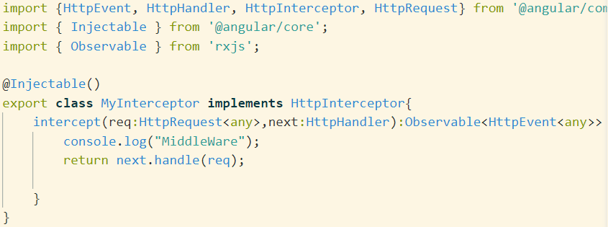
Interceptor class

Slide 152
Register the interceptor
You have to register the interceptor in app.module.ts file
{provide:HTTP_INTERCEPTORS,useClass:MyInterceptor,multi:true}]

Slide 153
Angular Testing – Service

Slide 154
Service Testing
To do Service Testing angular providing the from @angular/core/testing
Then we have to take the help of TestBed API to Configure the HttpClientModule.
beforeEach(() => {
TestBed.configureTestingModule({
imports:[HttpClientModule],
providers:[MyService]
});
service = TestBed.inject(MyService);

Slide 155
Angular Pipe

Slide 156
Angular pipe
In Angular 9, pipe (filter) is use to format the data.
A pipe takes in data as input and transforms it to a desired output.
So In Angular we use the | pipe character to format our data.
Currency
Date
Decimal
Json
lowercase and uppercase
percent
Async

Slide 157
Currency
The currency pipe allow to format numbers in different currencies.
{{price | currency:'CAD'}}
{{price | currency:'USD':true}}
{{price | curency :'EUR':false:3.2-1}}
{{price|currency:'&#8377'}}
The first argument is a string with the local currency code.
The second possible argument is a boolean to show the that will show either the currency symbol or the currency code. The default is false and shows the currency code.
The third possible is a string in the format of the decimal pipe to format the number.

Slide 158
Date
Format date values with the Date pipe
{{someDate | date :'medium'}}
{{someDate | date : 'fullDate'}}
{{someDate | date : 'yy'}}
{{someDate | date : ''Hm'}}
You can use a number symbol to define a custom format or you can also use a number of predefined keywords. The available keywords are following : "medium", "short", "fullDate", "longDate", "mediumDate", "shortDate", "mediumTime", "shortTime".

Slide 159
Decimal
Decimal
The Decimal pipe formats decimal values
{{ decimalvalue | number :'4.3-5'}}
In the above example, 4 is the minimum number of integer digits, 3 is for the minimum number of fraction digits and 5 is for the maximum number of fraction digits.

Slide 160
Json and upercase/lowercase
Json : The Json pipe is useful for debugging and dispalys an object as a json string. It uses JSON.stringify behind the scenses.
{{someObjet| json}}
lowercase and uppercase : Convet text to either lower case or upper case with the respective pipe.
{{user.name |upercase }}
{{user.name |lowercase}}

Slide 161
Percentage
Percet : The percet pipe transform a number into its percentage value
{{decimalValue | percent }}
Slice : Create a subset list or string with the Slice pipe
{{ someText | slice :3:6}}
<ul>
<li *ngFor="let item of someList | slice:2">
{{item }}
</li>
</ul>

Slide 162
Async
Async : The Async pipe automatically subscribes to an Observable or a Promise and returns the emitted values as they come in
<ul>
<li @ngFor="let item of data | async">
{{item.name}}
</li>
</ul>

Slide 163
Custom pipe
A custom pipe is created using a Pipe decorator on a class with a name property.
The value of the name is used as a template expression while calling custom pipe, and a class must implement PipeTransform which is inside @angular/core.
It is an interface which has transform method, which takes the values that has to be piped

Slide 164
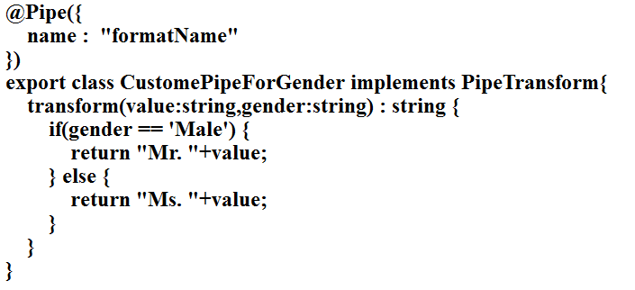
Example of custom pipe

Slide 165
Angular Routing

Slide 166
Routing
Routing helps to direct to different pages based on the options user select, using Routing you can render components to the users based on the options they select.
So the browser doesn’t load the whole page instead it only loads the component which we selected at runtime;

Slide 167
Steps to create the routing
Create the .ts routing file (app.routing.ts)
Import the NgModule from @angular/core, Routes and RouterModule from @angular/router' and all component which want to route at runtime.
Now we have to create the variable of type Routes. Which contains path and component property based upon the number of component want to route.

Slide 168
Syntax
const routes:Routes=[
{path:’’,redirectTo=“\first”,pathMatch=“full”},
{path:'first',component:FirstComponent},
{path:'second',component:SecondComponent},
{path:'third',component:ThirdComponent,
children:[
{path:‘thirdone',component:ThirdOneComponent},
{path:‘thirdtwo,component:ThirdTwoComponent,
]}
]

Slide 169
Continue...
Then create the class with @ngModule and use the two properties as import and export.
With following syntax
imports:[RouterModule.forRoot(routes)],
exports:[RouterModule]

Slide 170
In template
<div>
<a routerLink=“[‘/first’]">First Component</a>
<a routerLink=“[‘/second’]">Second Component</a>
<a routerLink=“[‘/third’]">Third Component</a>
</div>
<div>
<router-outlet></router-outlet>
</div>

Slide 171
Child Routes

Slide 172
const usersRoutes: Routes = [
{ path: 'users', component: Users },
{ path: 'users/:id', component: User }
];
Or
const usersRoutes: Routes = [
{ path: 'users',
children: [
{ path: '', component: Users },
{ path: ':id', component: User }
]
}];

Slide 173
ActivatedRoute
ActivatedRoute Contains the information about a route associated with a component loaded in an outlet.
It can also be used to pass data from one component to another component using route such as Id, flag, state etc
Using ActivatedRoute we can navigate from one component to another component programmatically.

Slide 174
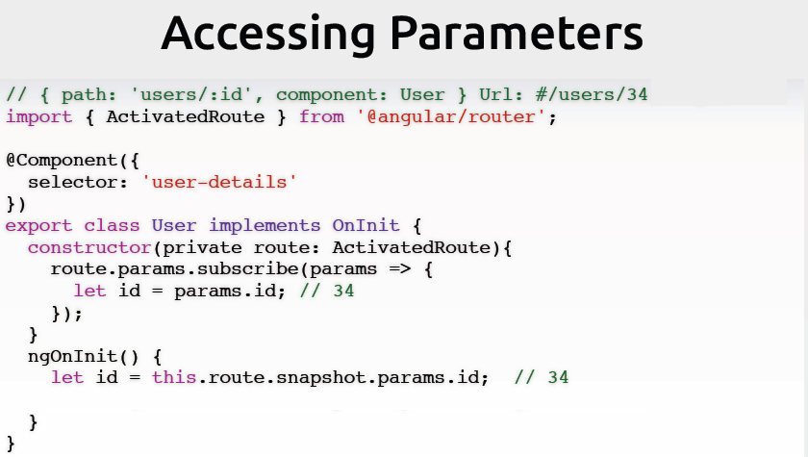

Slide 175
Navigation Guards

Slide 176
Route Guards
Router guards is mainly use to do the authorization base upon the roles.
Angular’s route guards are interfaces which can tell the router whether or not it should allow navigation to a requested route.
They make this decision by looking for a true or false return value from a class which implements the given guard interface.

Slide 177
Types of guards
here are five different types of guards and each of them is called in a particular sequence.
CanActivate
CanActivateChild
CanDeactivate
CanLoad
Resolve

Slide 178
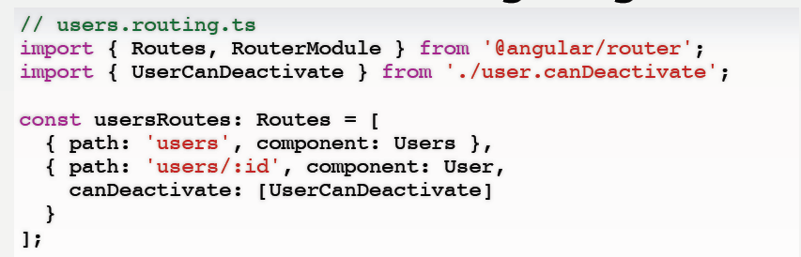
Ask before navigating

Slide 179
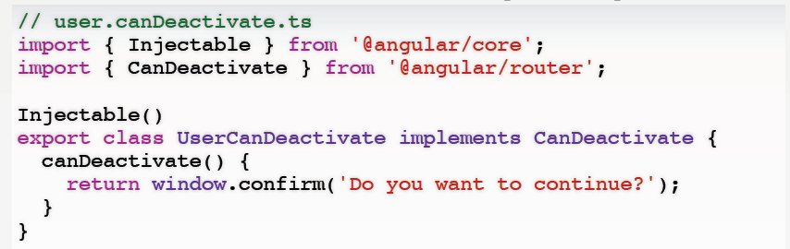

Slide 180
AuthGaurd class code
export class AuthGuard implements CanActivate{ constructor(private userService:UserService,private router:Router){}
canActivate() {
if(!this.userService.isAuthenticated()){
this.router.navigate(['main/login']);
return false;
}else {
return true;
}
}
}

Slide 181
Modify in the routing file
{path: 'dash' , component: DashboardComponent,canActivate:[AuthGuard]}

Slide 182
Creating Multiple Module

Slide 183
Creating new modules
This command is use to create the new module
ng generate module module_name
This command is use to create the new module with routing file
ng generate module module_name - -routing=true
Creating component inside a module
ng generate component component_name --module module_name

Slide 184
Angular module loading
In Angular module can loaded eagerly, lazily, and preloaded.
The application module i.e. AppModule is loaded eagerly before application starts. But the feature modules can be loaded either eagerly or lazily or preloaded.
Eager loading: To load a feature module eagerly we need to import it into application module using importsmetadata of @NgModule decorator.
Eager loading is useful in small size applications.

Slide 185
Continue...
Lazy loading: To load a feature module lazily we need to load it using loadChildren property in route configuration and that feature module must not be imported in application module.
Lazy loading is useful when the application size is growing.

Slide 186
Angular E2E Testing

Slide 187
E2E
End to End Testing.
Angular is use Protractor to do E2E testing.
Protractor is an open-source testing framework you can use to perform end-to-end testing on Angular apps.
This framework acts like a combination of different solutions. It can integrate several pieces of technology, such as NodeJS, Jasmine, Selenium, Mocha, and many more
End-to-end testing is a testing technique that exercises an application in its entirety, verifying whether its flow, from beginning to end, behaves as expected.

Slide 188
Running Protractor
We need two things to run the tests:
A server running our application
An instance of a webdriver through protractor
Use the global variable browser to navigate in the web page
Use element and by to call an HTML element:
callButton = element(by.tagName('button'));
First run the pretest to update the webdriver
When running the test, a browser will briefly appear and disappear, and the test results will be displayed in the console

Slide 189
Angular Ivy

Slide 190
Angular Ivy
Angular Ivy is a next generation compilation and rendering pipeline, which reduce the bundle size, load aster is slower networks and is simple to use.
In Angular 9 AOT compilation with Ivy is faster and should be used by default.
AOT means (Ahead of time compilation)

Slide 191
Optimization
AOT: (Ahead of time compilation)As opposed to JIT Compilation where the compilation is done in the browser, AOT compiles much of the code during the build process (also called offline compilation) thus reducing much of the processing overhead on the client browser. With angular-cli just specify the “aot” flag (if prod flag is present, then aot flag not required) and AOT will be enabled.
ng build –aot = true
By default when you run the ng build it is consider as development environment. But if you want production envirionment then we have to use the command as
ng build –prod

Slide 192
Continue...
Prod flag: For the production, build specify the “prod” flag in the angular-cli application. It will enable various build optimizations like uglify, AOT, removal of sourcemaps, service workers (if enabled) producing a much smaller build size.
Build-optimizer flag: If you are using angular-cli make sure you specify “build-optimizer” flag for your production build. This will disable the vendor chunk and will result in more smaller code.

Slide 193
Continue...
Lazy loading: Lazy loading is the mechanism where instead of loading complete app, we load only the modules which are required at the moment thereby reducing the initial load time. In simple words, it means “don’t load something which you don’t need.”
Server side rendering: Rendering the first page of your application on the server (using Node.js, .Net, PHP) and serving it as a static page causes near to instant rendering thus greatly improves perceived performance, speed, and overall user experience. You can use Angular Universal to perform server side rendering.

Slide 194
Continue...
Progressive Web App: PWA makes your app load much faster, it gives the offline capability to your app and gives near native app experience thus greatly improving overall perceived performance by the user.
Updating Angular and angular-cli: Updating your Angular and angular-cli regularly gives you the benefit of many performance optimizations, bug fixes, new features, security etc.

Slide 195
Continue...
Third party packages: Review the third party packages you are using and see if better and smaller alternative is available as it may reduce the final size of your build.
Change Detection: By default on each asynchronous event, Angular performs a dirty checking by performing a change detection for the whole component tree. Such dirty checking could be a lot computation heavy for a medium to large apps. You can drastically reduce the change detection by setting “ChangeDetectionStrategy” to “OnPush”. The OnPush strategy promotes the use of immutable data structures.

Slide 196
Continue...
@Component({
selector: 'app-demo',
templateUrl: './demo.component.html', changeDetection: ChangeDetectionStrategy.OnPush}
)

Slide 197
Continue...
Detach Change Detector: We can completely detach the component from change detection thereby giving a developer the control to inform Angular as to when and where to perform the change detection.

Slide 198
Continue...
constructor(private cdr: ChangeDetectorRef) {}
ngAfterViewInit() {
// We only want to detach the change detectors after change detection has been
// performed for the first time
this.cdr.detach(); }
update() { // Run change detection only for this component when update() method is called.
this.cdr.detectChanges();
}

Slide 199
Continue...
Web Workers: The JavaScript implementation in all browser is single threaded thus making the whole app to run on a single thread. Such single-threaded execution drastically reduces the frame rate of the complex application as both UI painting and JS execution handled by the same thread. As Angular by default avoids direct DOM manipulation, it is possible to run the entire Angular app in a separate web worker thread thereby keeping the main thread free to just handle the UI rendering.

Slide 200
Deploy the project in external server
Once we created the application from Angular-CLI, we get all the configurations in the project itself for developing an app whose size will be almost 160MB or more.
but when we deploy these applications on the server we need the build files which can process the requests from the client whose size will be less than 1MB, to build the applications and deploy in Tomcat server or any web server.
ng build

Slide 201
After ng build, you can see there is dist folder will create then folder we have to copy and paste in server. It may be web server or application server.
ng build --base-href=/angular/
ng invokes angular
build asks angular to build current app
–base-href tells angular to create a reference directory where generated index.html file will be placed. So, in current case, generated files need to be placed in /angular folder in tomcat directory structure.

Slide 202
Deploy the project in external server
Once we created the application from Angular-CLI, we get all the configurations in the project itself for developing an app whose size will be almost 160MB or more.
but when we deploy these applications on the server we need the build files which can process the requests from the client whose size will be less than 1MB, to build the applications and deploy in Tomcat server or any web server.
ng build

Slide 203
After ng build, you can see there is dist folder will create then folder we have to copy and paste in server. It may be web server or application server.
ng build --base-href=/angular/
ng invokes angular
build asks angular to build current app
–base-href tells angular to create a reference directory where generated index.html file will be placed. So, in current case, generated files need to be placed in /angular folder in tomcat directory structure.

